Slide 1
Understanding Health and Wellness through Microbiome research
30th July – 1st August 2025
Dr. Tarini Shankar Ghosh
Microbiome Informatics
IIIT-Delhi
Day 3
Lecture 2

Slide 2
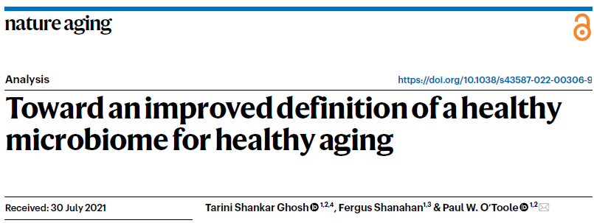
Case Study 2: Gut Microbiome and Aging
Alterations of the gut microbiome with aging and unhealthy aging

Slide 3
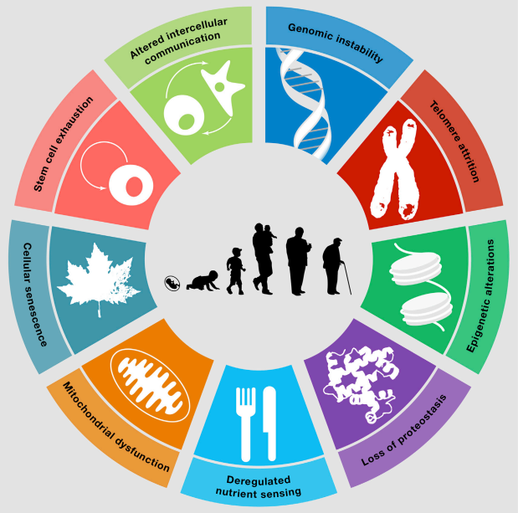
Gut Microbiome relationship with aging
Biological Aging
Deterioration in host physiology
?
Gut Microbiome
?
?
Changes in life-style, diet and medications
Lopez-Otin et al Cell

Slide 4
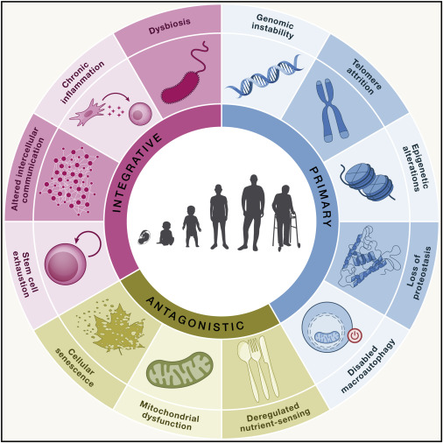
Dysbiosis has been included as a new hallmark in the 2023 extended hallmarks of aging

Slide 5
What do we know about the gut microbiome changes across the aging landscape?

Slide 6
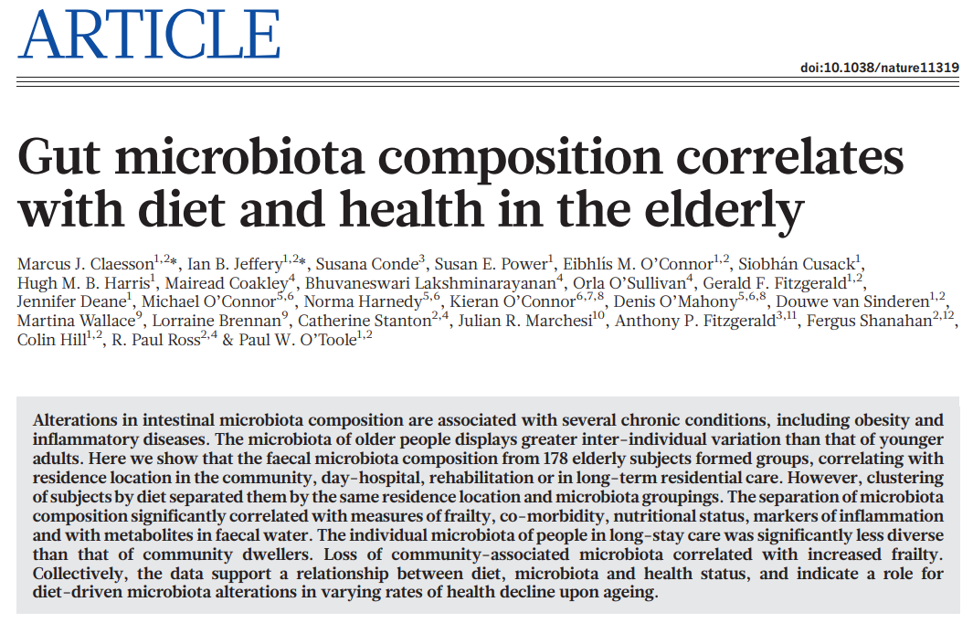
ELDERMET Study…
The first gut microbiome study focusing on older people (Age >= 65 years)
Community: Community-dwelling apparently healthy older people
Longstay: Unhealthy older people residing permanently in residential care
Rehab: Reduced duration in residential care
Day Hospital: Single day hospital visit
178 Subjects
Longstay
Day Hospital
Rehab
Community
Young
Unhealthy
Healthy
Different classes of older people

Slide 7
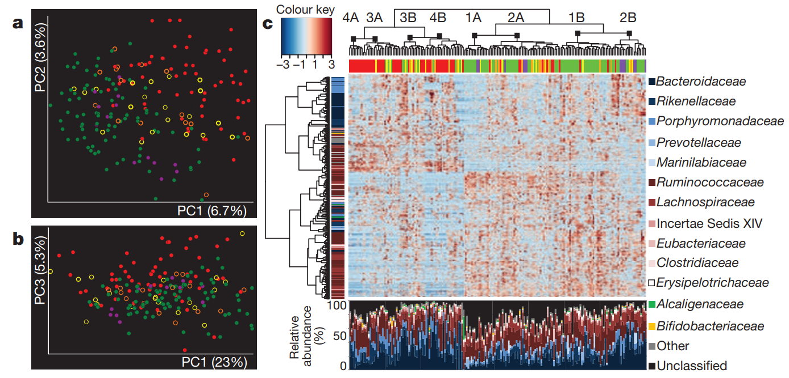
The apparently community-dwelling elderly had a microbiome composition very similar to the young
Longstay
Day Hospital
Rehab
Community
Young
Claesson et al Nature 2012

Slide 8
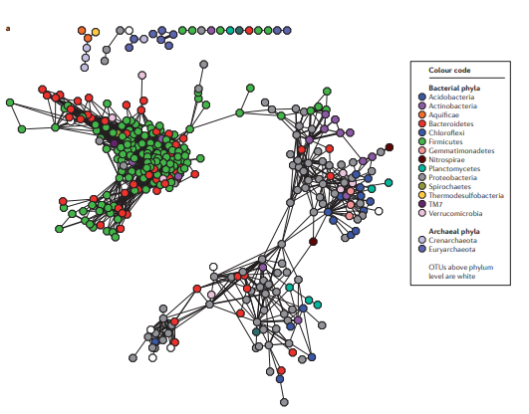

Concept of the core and keystone gut microbiome
1. Detected in a large majority of samples
2. Occupy the most central nodes in the co-abundance network
Core Gut Microbiome
Individual Gut Microbiomes
Detected
Species-level taxa detection profile

Slide 9
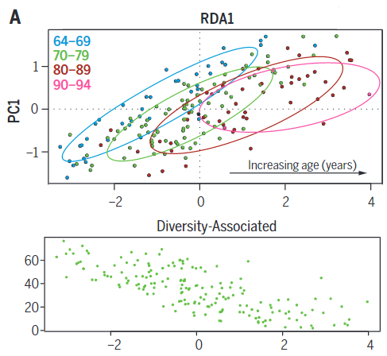
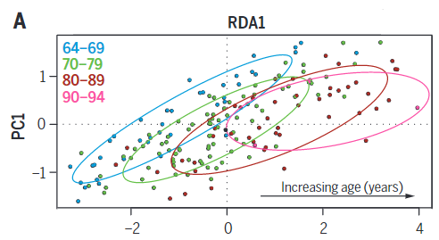
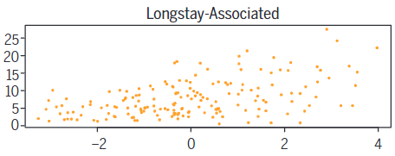
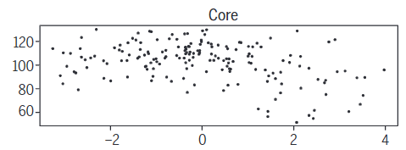
Loss of core and diversity-associated species modules gut microbiome species modules a feature of aging in general
O’Toole and Jeffery et al Science 2016

Slide 10
Questions
What are these exact core or diversity-associated and longstay-associated species?
Is the loss of core and increase of longstay-associated microbes the only microbiome changes accompanying aging?
Can we distinguish between normal aging and unhealthy aging?

Slide 11
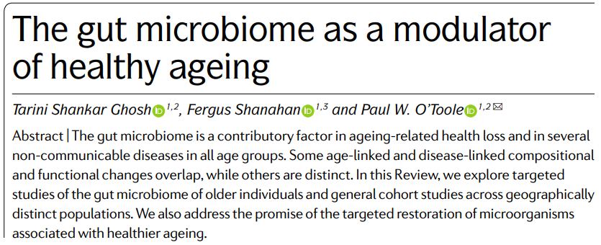
Systematic review of microbiome studies and aging

Slide 12
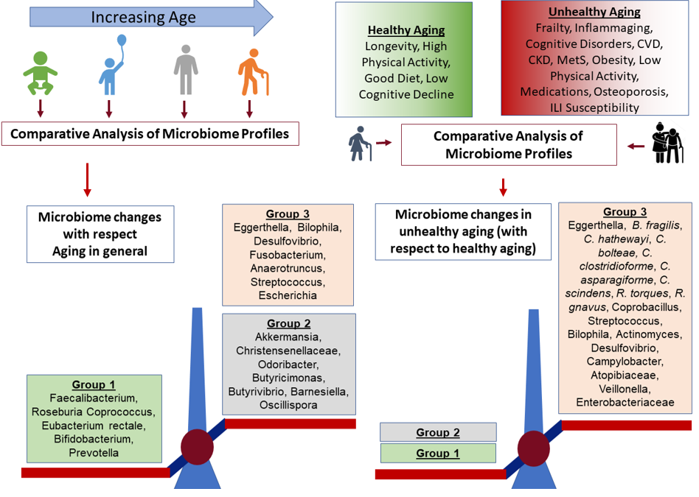
Three distinct groups within the gut microbiome with differential links to aging and unhealthy aging
Systematic Review (> 50 Published Aging-Microbiome Studies)
Microbiome Checkpoints for Unhealthy Aging

Slide 13
To summarize
Group 1: Butyrate producing core
(List of microbes in previous slide)
Group 2: Pathobionts
(List of microbes in previous slide)
Normal Old
Unhealthy Old
Abundance
Abundance
Unhealthy Old
Normal Old
Age
Age
Normal Old
Group 3: Akkermansia,
Alternate Butyrate producers
Abundance
Back
Unhealthy Old
Age

Slide 14
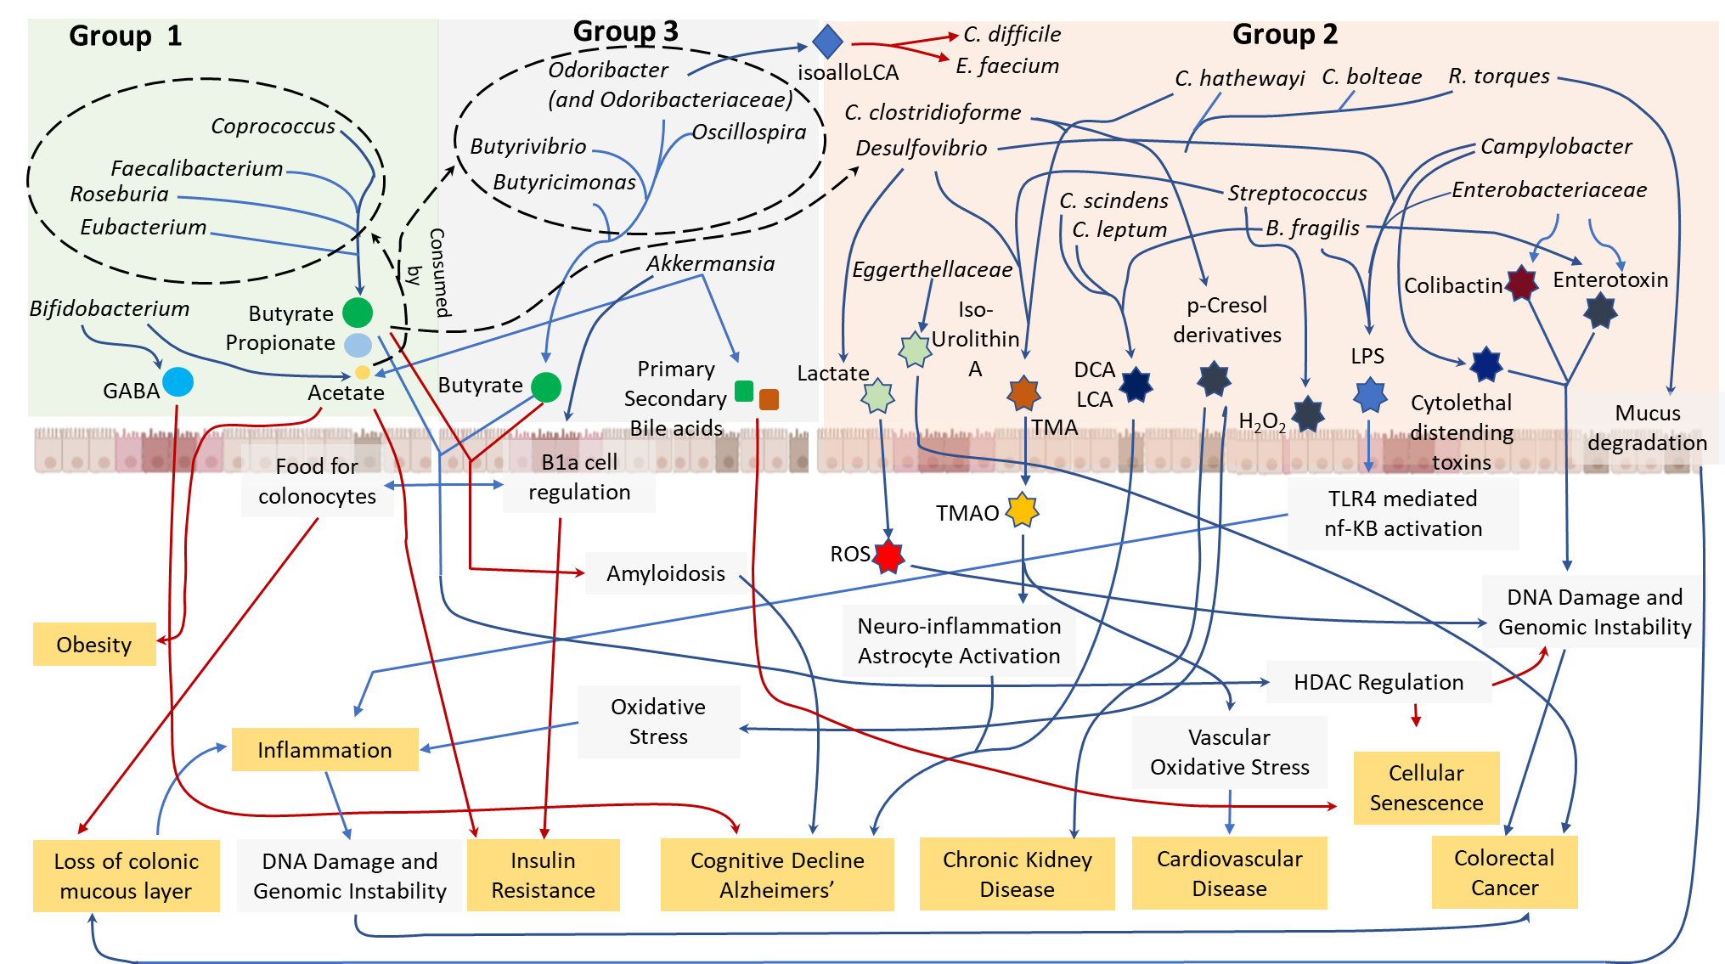
Investigating the metabolic profiles of these microbes further provide clues into the mechanistic links behind these associations

Slide 15
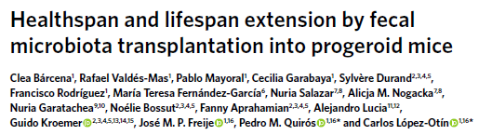
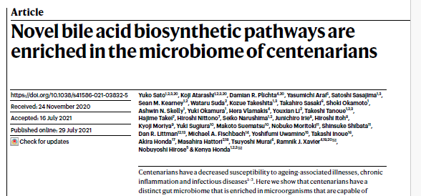
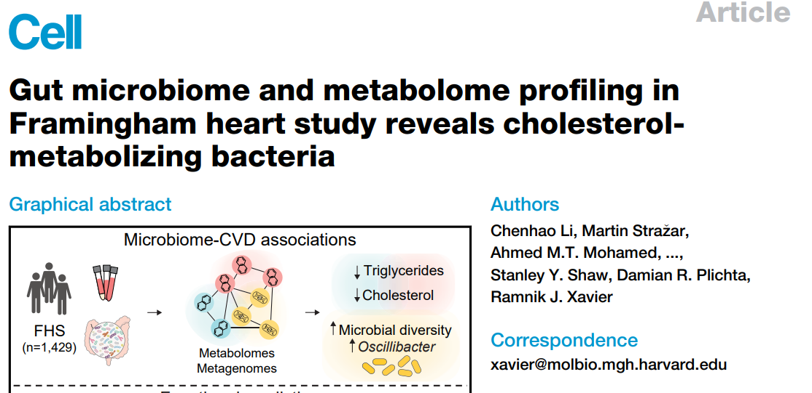
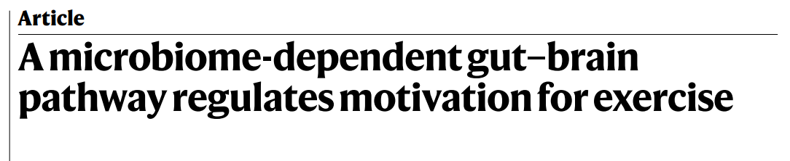
Summarizing
The microbes that are positively associated with healthy aging are not only simply alternate Butyrate producers but…
Akkermansia muciniphila > Progeria
Odoribacteriaceae: Iso-Allyl-LCA: Antimicrobial Activity
Coprococcus + Eubacterium: High Physical Activity (Endocannabinoid molecules+ Dopamine Signalling)
Oscillibacter > Improved Lipid Metabolism

Slide 16

Cover-page

Slide 17
Issues remained
All the studies were performed using different techniques
Different populations
Different profiling
Can we adopt a more systematic data-driven approach to address these variations and come up with consistent markers of healthy aging and unhealthy aging
Are the signatures consistent across all geographies?

Slide 18
One of the largest analysis of gut microbiome data in the context of aging
Alterations of the gut microbiome with aging and unhealthy aging
Used a global collation of > 21,000 gut microbiomes from 29 different study cohorts

Slide 19
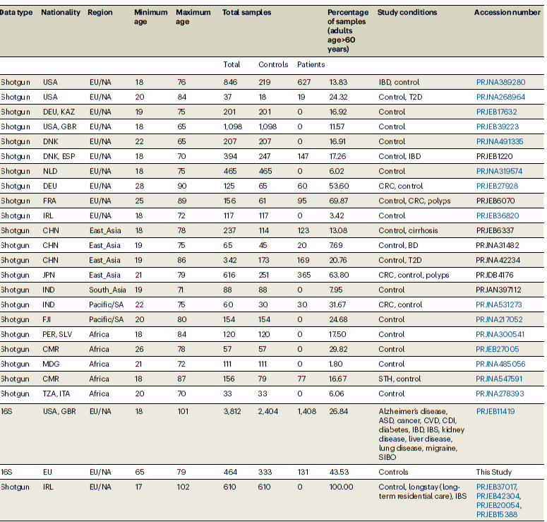
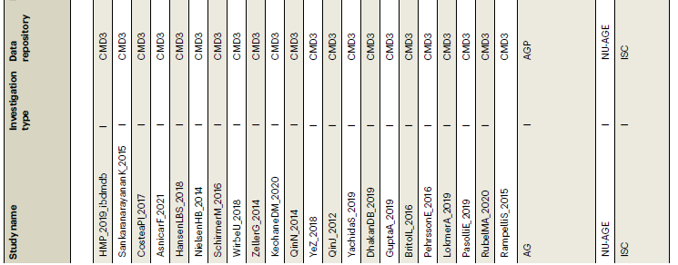
Full Dataset

Slide 20
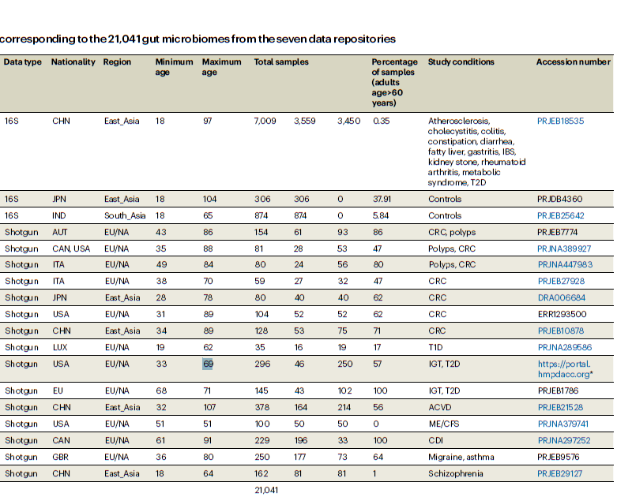
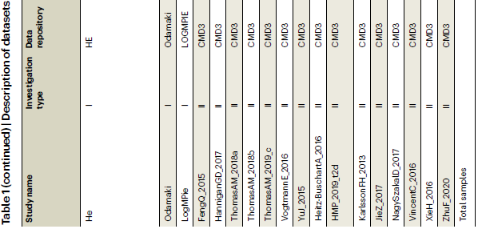
Full Dataset
The majority of the study cohorts were in curatedMetagenomicData. Rest were downloaded manually by looking into the individual papers. See next

Slide 21

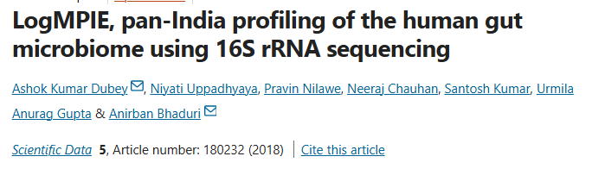
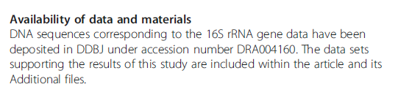
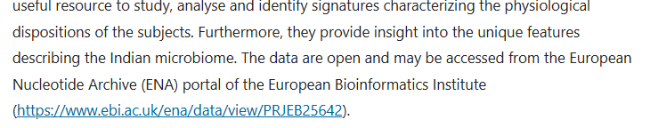
Example…

Slide 22
Questions
How does alpha and beta diversity vary with age?
Can we identify microbes that consistently link with alpha and beta-diversity?
Microbes that are negatively linked associated with microbiome homeostasis
Anna-Karenina Principle
Their ecological placement in the gut microbiome
Can we order the microbes based on their consistent positive and negative association with health in older people?

Slide 23
How does alpha and beta diversity vary with age?

Slide 24
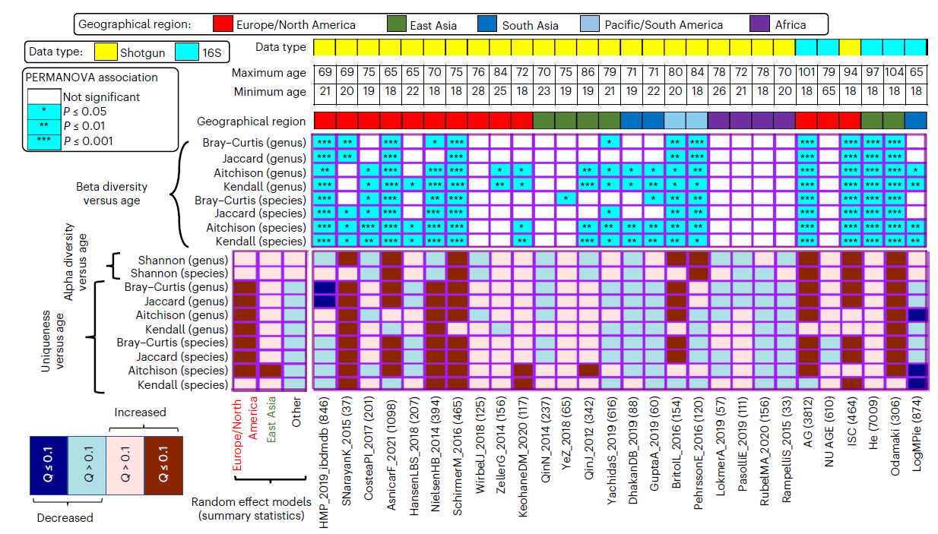
Increase in age is associated with increase in beta-diversity but only in Industrialized societies

Slide 25
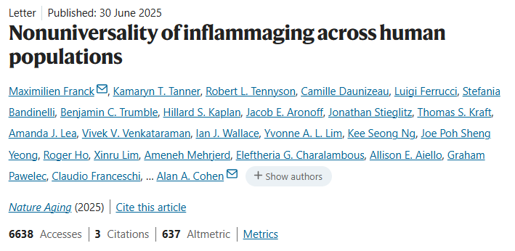
Resonates well with the findings of a recent study
Inflammaging is a phenomena that seems to be associated only with industrialized societies

Slide 26
Can we identify microbes that consistently link with alpha and beta-diversity?

Slide 27
Some concepts
Concept of Uniqueness
Microbes positively associated with Uniqueness may not be good
Distance to nearest sample: Uniqueness
Microbiomes
Beta-Diversity
Distance
Measure
Aitchison
Kendall
Shannon
Bray
Association Analysis
Microbiomes
Meta-Analysis
Uniqueness

Slide 28
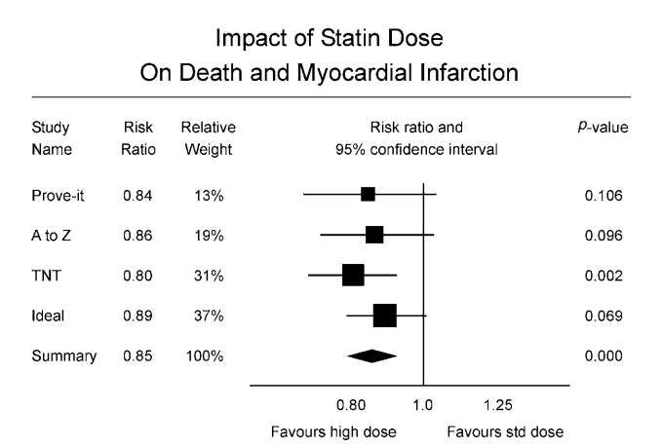
Some concepts
What is a Meta-Analysis?
Meta-Analysis is an approach where we use statistical methods to investigate the results of multiple studies (like we have here) to answer a given question
Each study is treated separately but is assigned a weight that is indicative of its reliability
The final outcome of the meta-analysis is summarized weighted estimate or verdict: Whether based on the data from all these studies - Do we see a significant positive or negative effect or association?

Slide 29
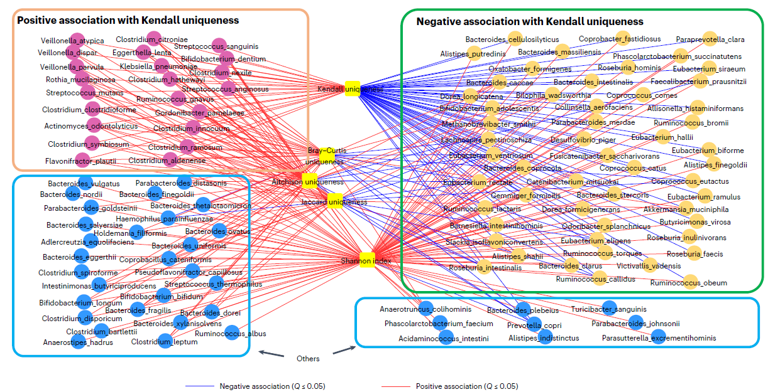
Specific groups of species are associated with positively and negatively with Kendall Uniqueness
Higher Kendall Uniqueness > Higher divergence of the microbiome from non-diseased
Previous

Slide 30
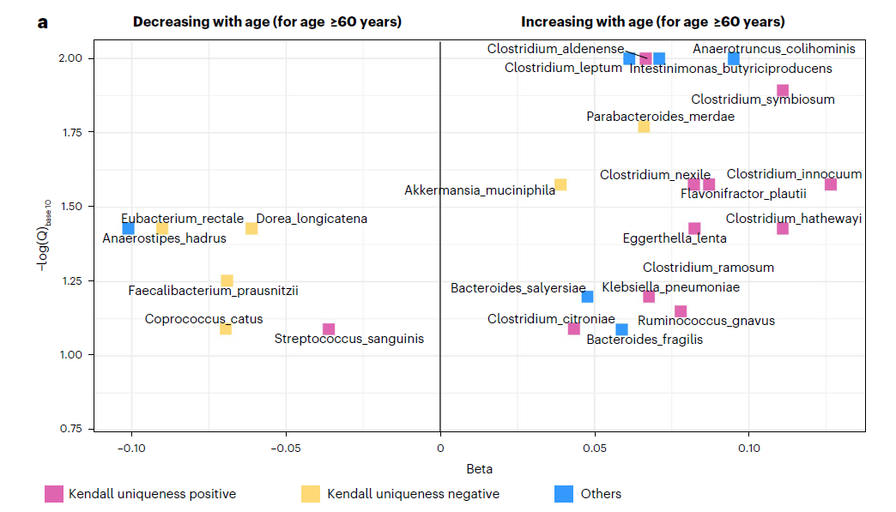
Meta-Analysis of microbes abundance with age identifies consistent aging associated markers

Slide 31
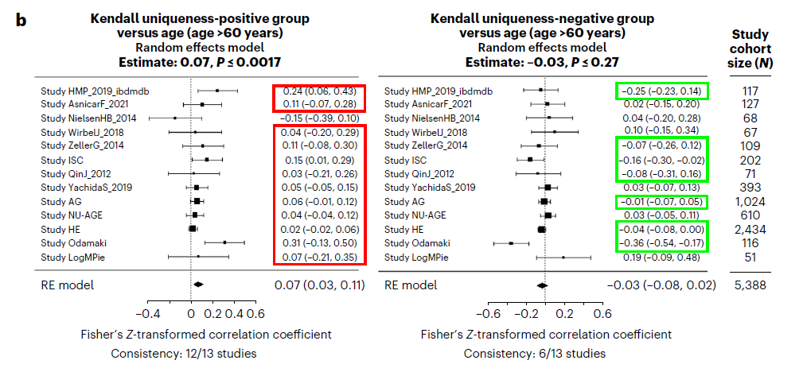
Kendall-Uniqueness linked group as a surrogate measure for measuring aging-associated microbiome decline
What is the implication: From a large list of ~ 1000 microbes, this investigation narrowed on a subset of a few (around 20 in meta-analysis) and ~ 45 (taking all as a group) microbes consistently linked to aging-associated microbiome decline

Slide 32
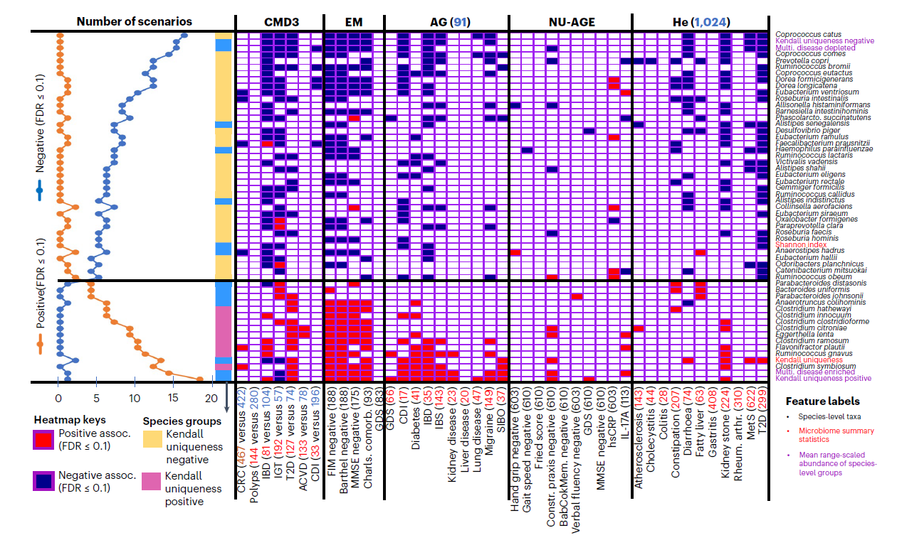
We also ranked these microbes based to create a priority list based on their associations with diseases in older people?

Slide 33
We then investigated the community placements of these microbes
Community-level analysis: How microbes associate with each other as modules
Some basics into how we build intra-microbe co-abundance/co-occurrence networks
Microbe2
Microbe1
Microbe2
Microbe1
Repeat for all microbe pairs
Association
Microbiomes
Meta-Analysis
Significant
Association

Slide 34
Applications
Each microbiome is like a community
Interactions between the community members are important for ensuring the stability of the microbiome and maintaining homeostasis with the host
Distortions in these interactions lead to dysbiosis
Examples: Distortions in intra-microbiome interactions in the gut have been implicated in multiple diseases like Crohns, Obesity, Cancer etc.
Identifying co-occurring groups of taxa are helpful for performing a modular investigation of the microbiome, reducing noise and increasing statistical power of the tests.
Another application is identifying synergistic groups of microbial markers that can be used for therapeutic microbial consortia

Slide 35
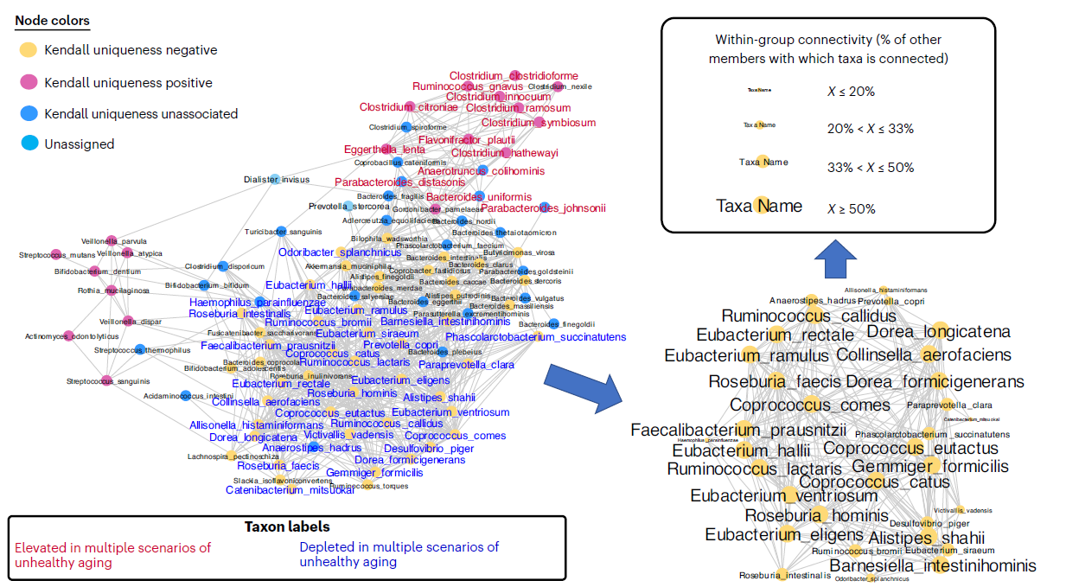
Healthy-aging associated markers occupy specific synergistic positions in the gut microbiome
Synergistic healthy-aging linked microbial consortia

Slide 36

Mice studies indicate improved cognitive activity and less susceptibility to infection

Slide 37
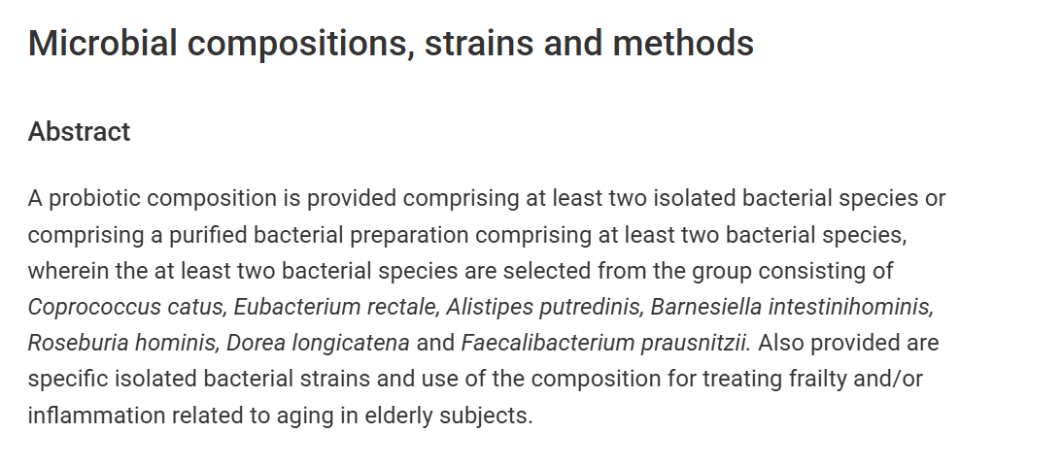

Patent filed
https://patents.google.com/patent/EP3808358A1/en

